Slide 1
A3.ba
Objects and Operations
Sabah Ul-Hasan
Credit: Huitian Dao

Slide 2
Zoom Poll
How are you feeling?
Good. I’m starting to get the hang of this.
Meh. Could be better, but I’m getting there.
Terrible. I’m constantly frustrated. The world is a mess, but at least there’s bioinformatics.
Notes:
Want to know if you encounter unwelcoming behavior outside or inside classroom

Slide 3





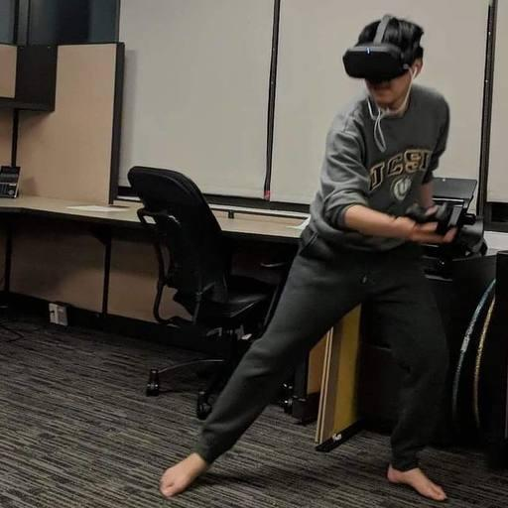


Reach out -- We’re here for you!
Expertise
Mentorship
Professionalism
Communicative
We’re humans, too (as are you!) We’ll be decompressing during non-business hours
Support of you being your healthiest self
Huitian Dao
Karthik Gangavarapu
Shang-Fu
Chen
Andrew Su
Sabah Ul-Hasan

Slide 4
Question 1
string <- TRUE ;what kind of object is ‘string’ ?
character numeric logical
Question 2
To convert a data.frame of different data types to the same types... I can split it into multiple matrices I can utilize the as.factor() function and adjust my code accordingly Both options are valid Neither option is valid
Question 3
What is the R Kernel equivalent for Python %%bash? system( ) bash( ) system{ }
Notes:
Want to know if you encounter unwelcoming behavior outside or inside classroom

Slide 5
What’s an Object?
R object can refer to a variable that is assigned a value/class (digit or letter) or equation
Variable types
Numeric
String
Character
Logical
Some ‘thing’ that the program can work with
Data types, scalars, vectors, etc
, it literally can be anything. Basic data types could be a scalar or vector.
https://data-flair.training/blogs/object-oriented-programming-in-r/

Slide 6
How to ‘Operate’ on an Object?

Slide 7
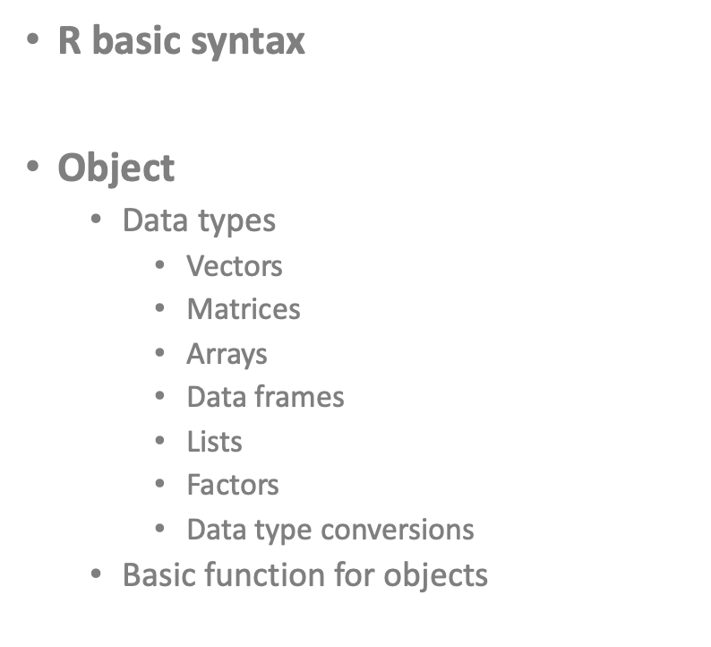
How to ‘Operate’ on an Object?

Slide 8
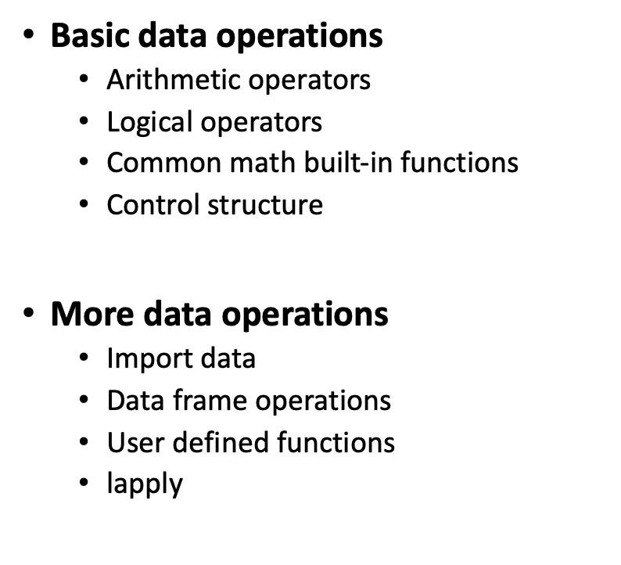
How to ‘Operate’ on an Object?

Slide 9
Statistical Analyses (2+3 demo cnt’d)
Arithmetic operators
+ | addition
- | subtraction
* | multiplication
/ | division
** or ^ | exponentiation
%% | modulus
%/% | integer division

Slide 10
Statistical Analyses (2+3 demo cnt’d)
Logical operators
> >= | Greater Greater or equal
< <= | Less Less or equal
== != | Equal to Not equal to
! | NOT
| | OR
& | AND
isTrue() | If … is true

Slide 11
Statistical Analyses (2+3 demo cnt’d)
abs() | Absolute value
sqrt() | Square root
ceiling() | Ceiling(3.457) is 4
floor() | Floor(3.457) is 3
trunc() | Trunc(5.99) is 5
round() | Round(3.457, digits=2) is 3.48
signif() | Signif(3.475, digits=2) is 3.5
sin() cos() tan() | Trigonometric functions
log() log10() | Natural logarithm or common logarithm
exp() | e^

Slide 12
Something Old (Loops), Something New (Conditionals)

Slide 13
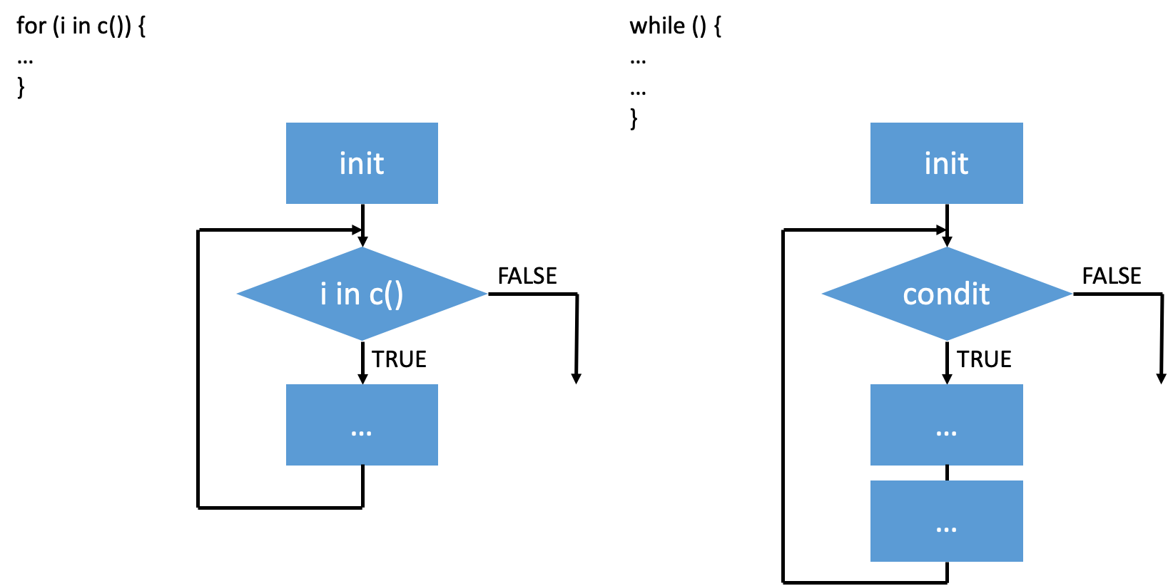
Something Old (Loops), Something New (Conditionals)

Slide 14
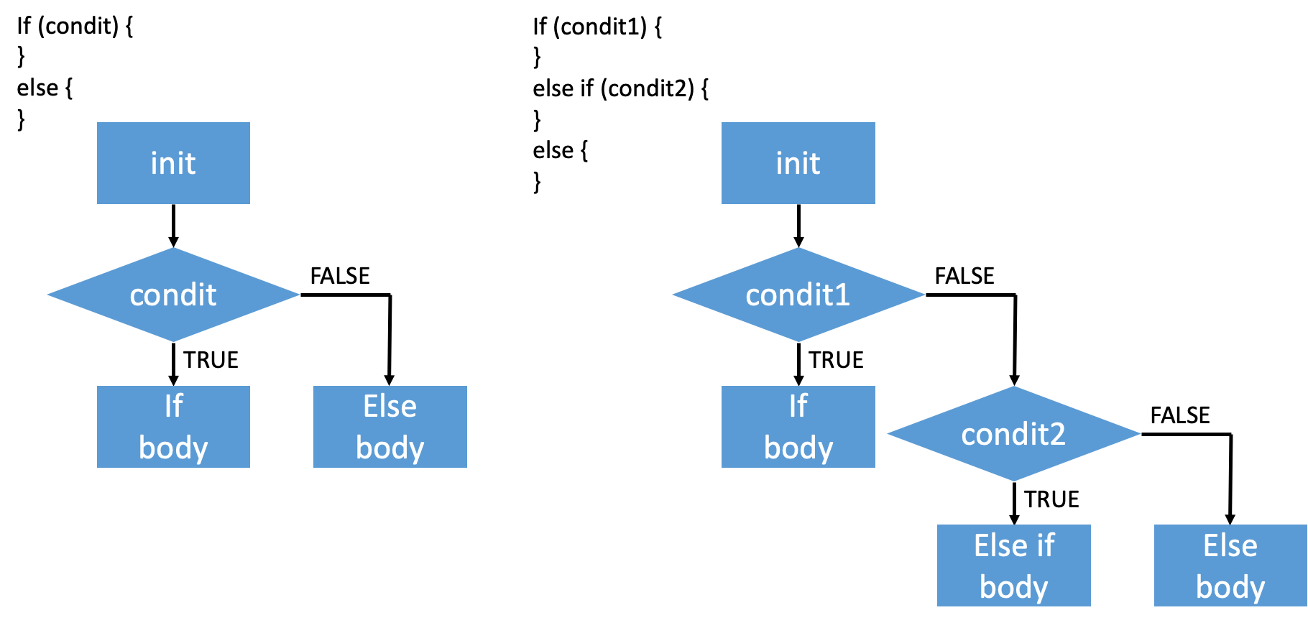
2+3 demo cnt’d
https://www.tutorialspoint.com/r/r_if_else_statement.htm
Notes:
Want to know if you encounter unwelcoming behavior outside or inside classroom

Slide 15
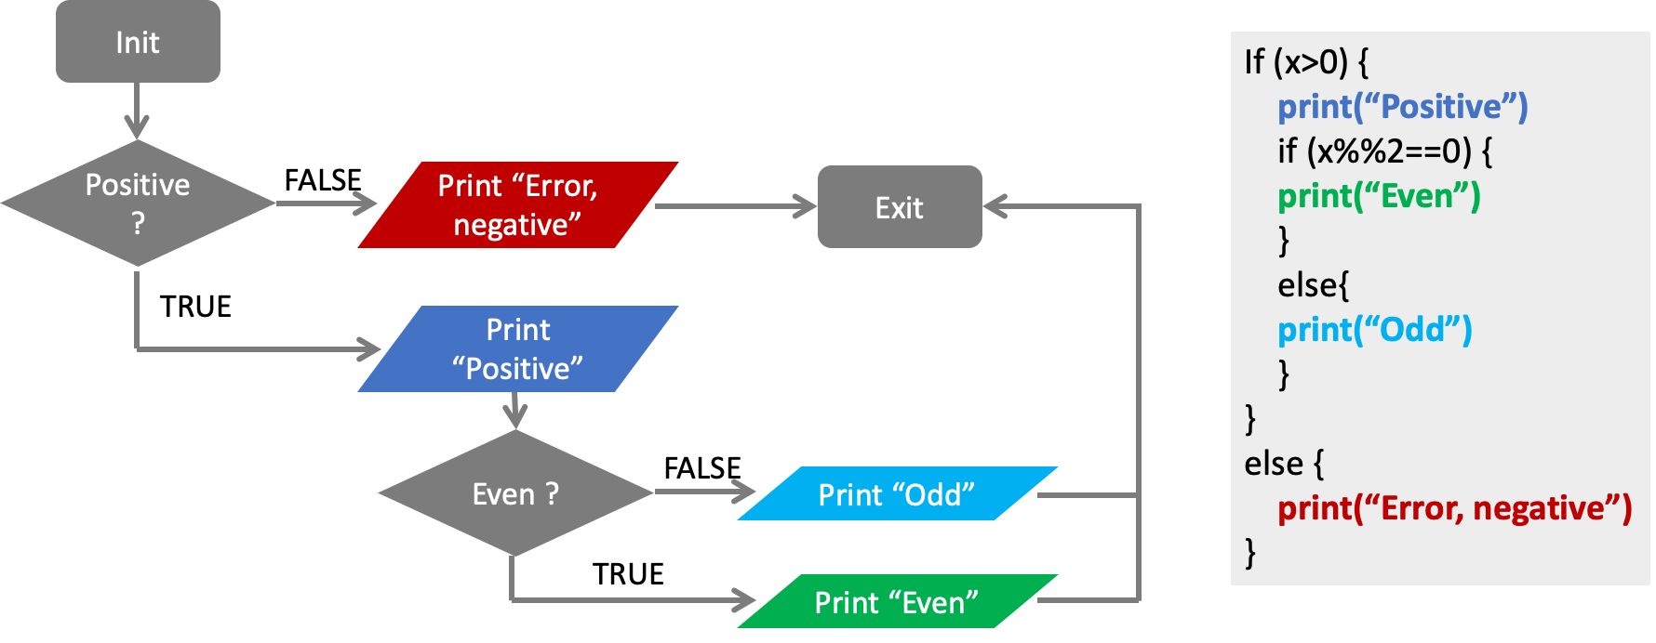
Notes:
Want to know if you encounter unwelcoming behavior outside or inside classroom

Slide 16

Think-Pair-Share
[ ] Open HW 3, complete A3.ba in pairs (or 3s)

Slide 17
A3.bb
Applying R to Biology
Sabah Ul-Hasan
Credit: Huitian Dao

Slide 18

Experimental Design - What goes into it?
Garbage in, garbage out
Controls: Negative and positive
Sample size
Validation and reproducibility (ie Github repos and script)
Putting thought into it
Batch effects, confirmation bias, confounding factors etc
Statistical tests and associated assumptions
Normal distribution, transformations, etc
https://www.statmethods.net/stats/power.html

Slide 19
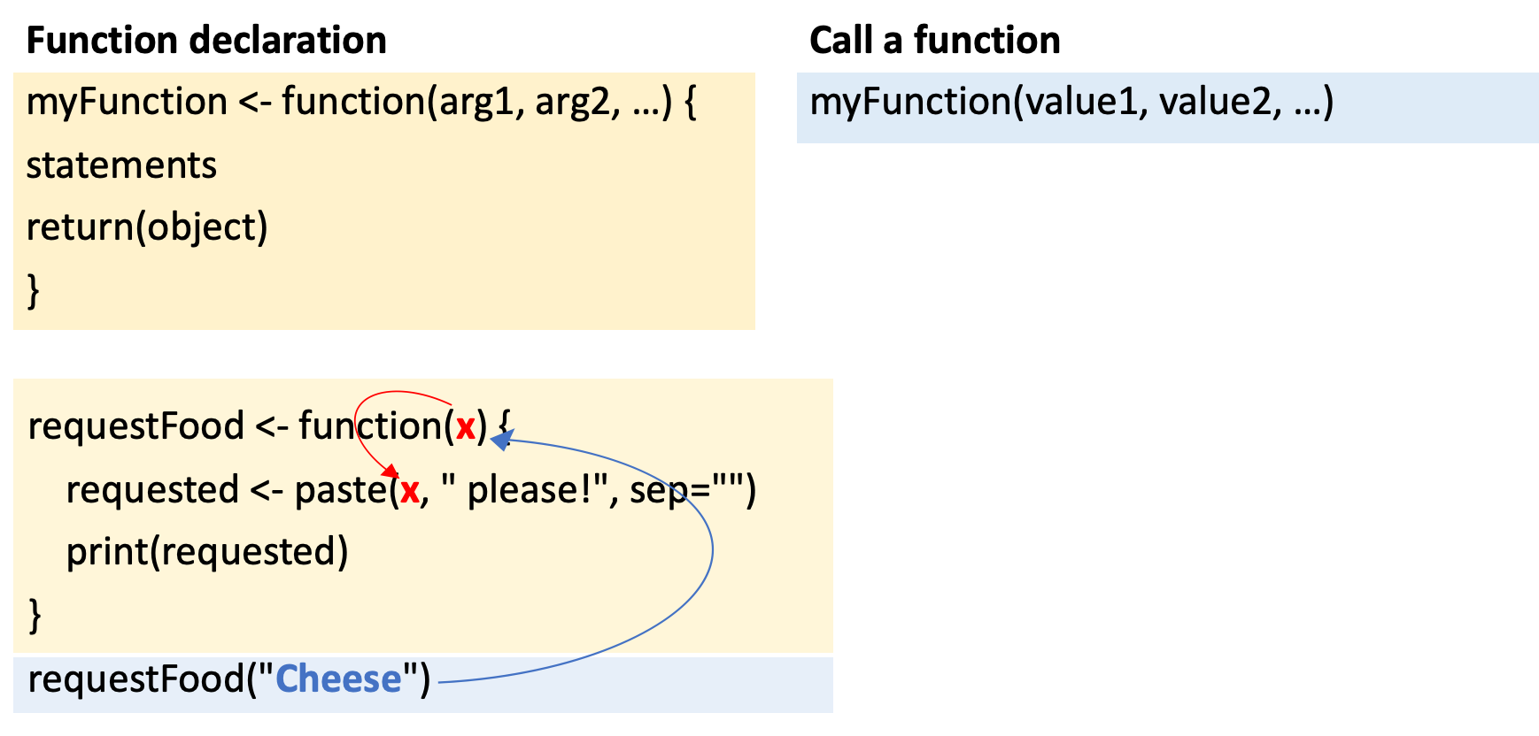
Functions
https://swcarpentry.github.io/r-novice-inflammation/02-func-R/

Slide 20
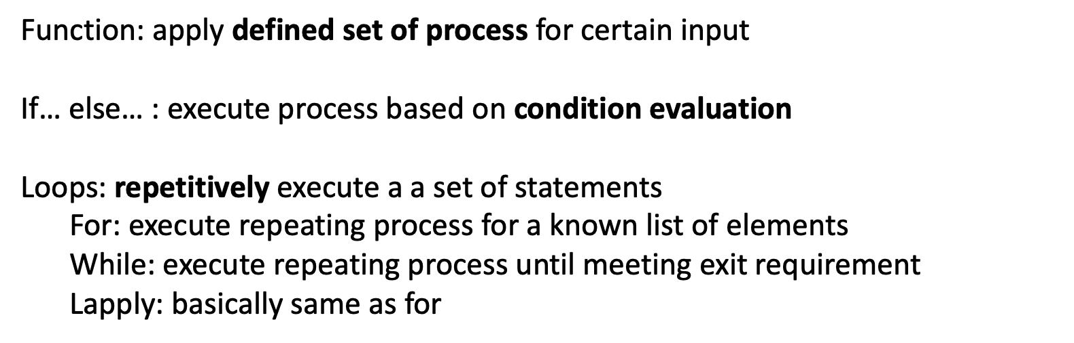
Summary

Slide 21

Individually,
[ ] Work through A3.bb Q9-10

Slide 22
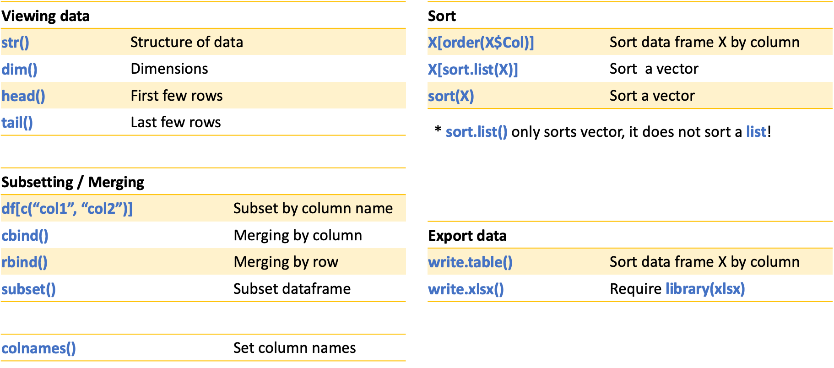
Dataframe operations

Slide 23
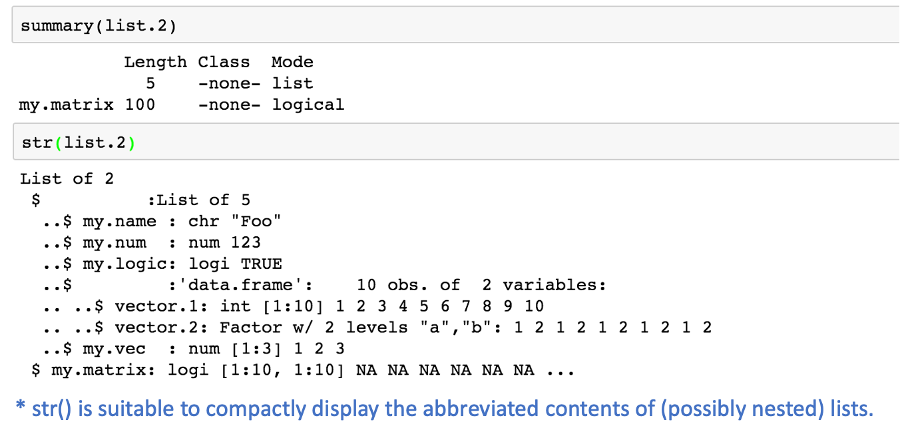
Viewing df with str()

